Slide 1
Online Shoppers Intention
By Aaditya Mahindrakar
aadmahindrakar007@gmail.com

Slide 2
Index
Introduction
Data Dictionary
EDA Part
Method 1
Method 2
Conclusion

Slide 3
Introduction
Data insights that highlights micro-movements of customer intent provides more opportunities to convert customers and drive revenue.
Using customer buying intentions as a measure to forecast sales and determine the effect of these customers in the future.
Boosting the growth of the company by overcoming the ‘Ecommerce challenges’ like marketing budget & converting shoppers into paying customers.

Slide 4
Problem statement This is the data of an online retailing company where they are trying to find which online shopper will generate revenue by his/her online shoppers’ activity on their site.
Objective
The objective of this project is to predict whether the visitor on site will buy the product.
The Machine Learning Classification Model can solve this objective, with data pre-processing & cleaning.
Let’s see the data..

Slide 5
Data Dictionary
Administrative : Page Name
Administrative_Duration : duration of customer stay in that Page
Informational : Page Name
Informational_Duration : duration of customer stay in that Page
ProductRelated : Page Name
ProductRelated_Duration (in min) : duration of customer stay in that Page
BounceRates : Measures the percentage of visitors to a website who navigate away from the site after viewing only one page
ExitRates : Measures the percentage of visitors who leave a website from a specific page, rather than continuing to view other pages on the site.

Slide 6
PageValues : Measures the average value of a webpage to a website's business. It is calculated by taking the total revenue generated by a webpage and dividing it by the number of views the page received.
SpecialDay (probability) : Special days are considered.
Month : Data taken from different months in a year
OperatingSystems : The OS used by consumers
Browser : Browser used by customers
Region : Regions coded as numbers
TrafficType : The visitor comes to the website from different sources.
VisitorType : Shows the visitor is First Time visitor or Returning visitor
Weekend : Whether the customers visited on weekend or not
Revenue : Target Column (the Customer generated the revenue or not)

Slide 7
Proposed System
Data
Data preprocessing
Feature Scaling
Random Forest Model
Training Data
Testing Data
New Data
Model Training
Classification Output

Slide 8
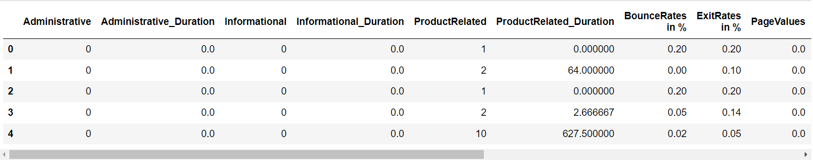
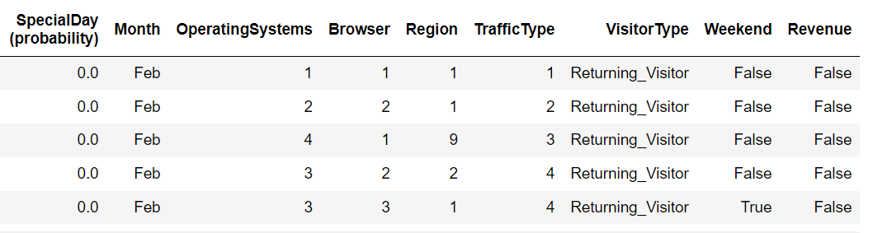
Data Analysis
The features 'Month’, 'OperatingSystems’, 'Browser’, 'Region’, 'TrafficType’, ‘VisitorType’ contains categorical data.
'Month’ & ‘VisitorType’ are object columns, ‘Weekend’ & ‘Revenue’ are Boolean columns

Slide 9
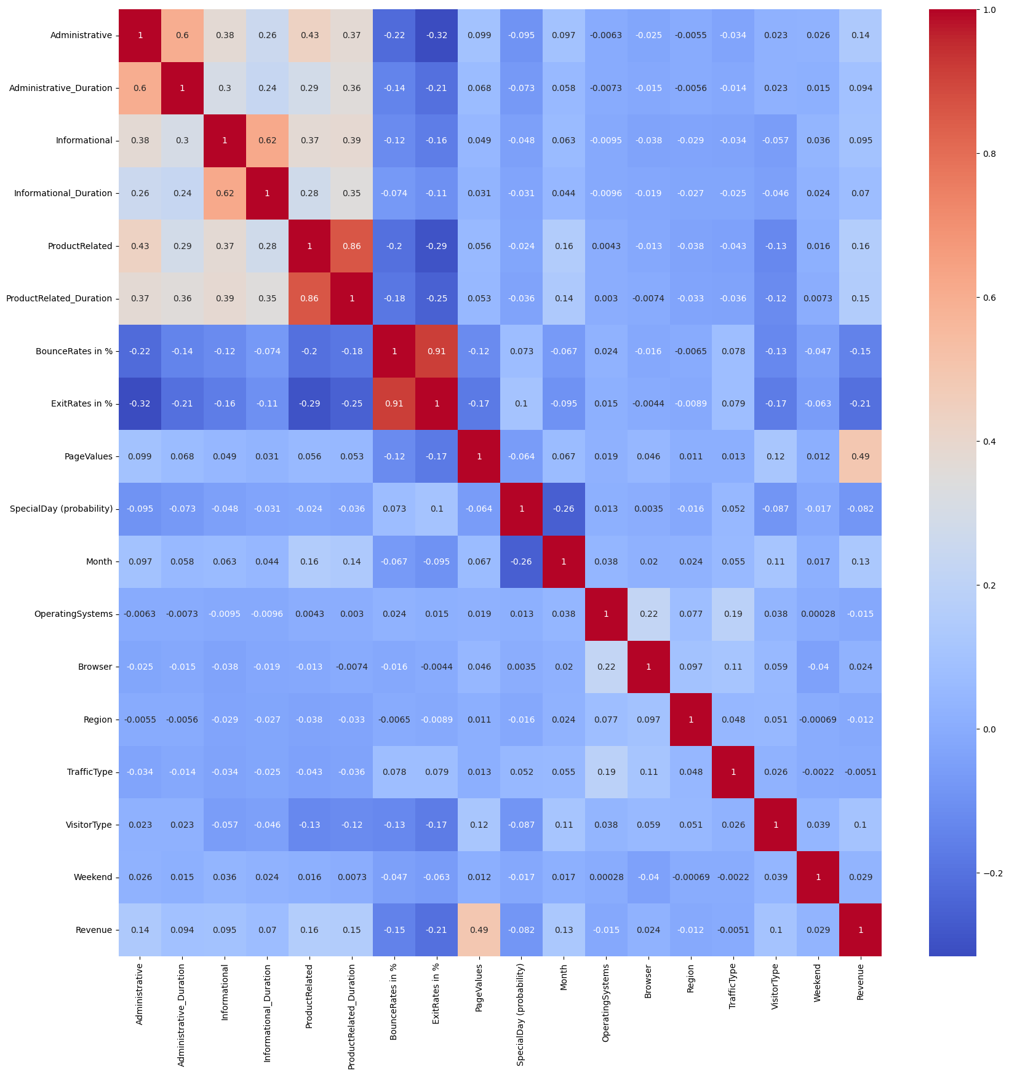
Important Feature is ‘page value’.
There is no multicollinearity

Slide 10
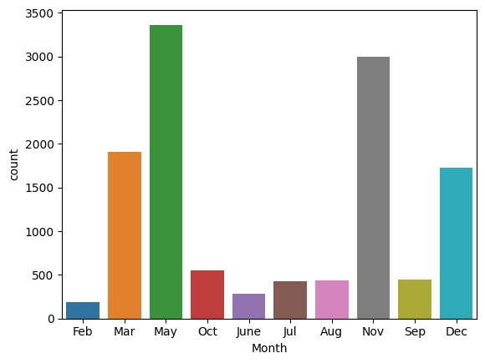
Month feature is missing two months January & April.
May & November is having more sales than any other month.

Slide 11
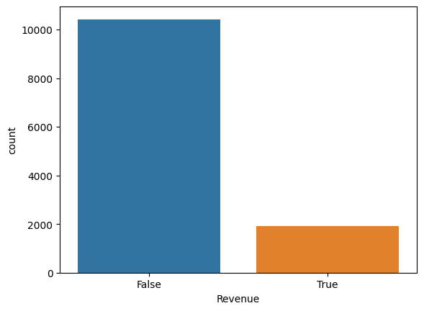
The data is imbalanced. Revenue generating customers less than online shoppers visiting the site.

Slide 12
Method 1
In Method 1 approach doing preprocessing on data.
For our model to understand the future data of January and April month, customizing the month feature by adding those months.
Converting the object & Boolean features to integers features.
Creating independent & dependent variable split.
Balancing the data.
Feature Scaling
Model building
Model Evaluating.
AUC ROC plot

Slide 13
Ensemble Learning Model
Predictive Model from the core of machine learning. Better the accuracy better the model is. And so the solution to the particular problem. The ensemble learning is the potent technique to improve the performance of machine learning model.
Ensemble learning techniques attempt to make the performance of the predictive models better by improving their accuracy. It is process using which multiple machine learning models(such as classifiers) are strategically constructed to solve a particular problem.

Slide 14
Random Forest
Random Forest is one of the most popular ensemble method in which several decision tree models are developed using different sampling strategies.
Ensemble model is the model that has combined with all base models & generate the ensemble model.
Base model of RF is decision tree model.

Slide 15
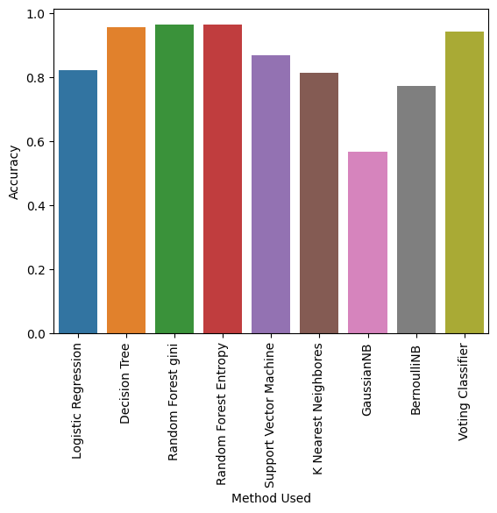
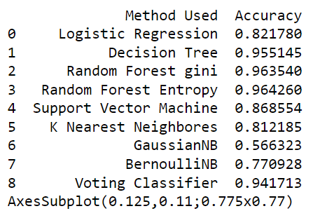

Slide 16
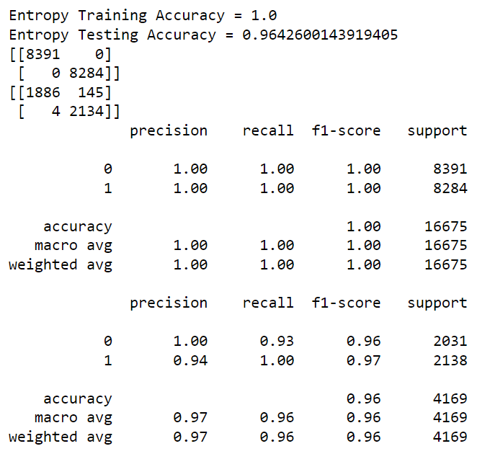
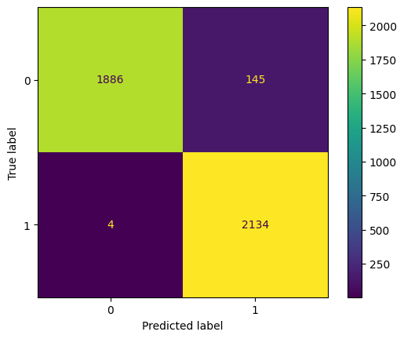
Evaluating Random Forest Entropy model
Confusion Matrix plot

Slide 17
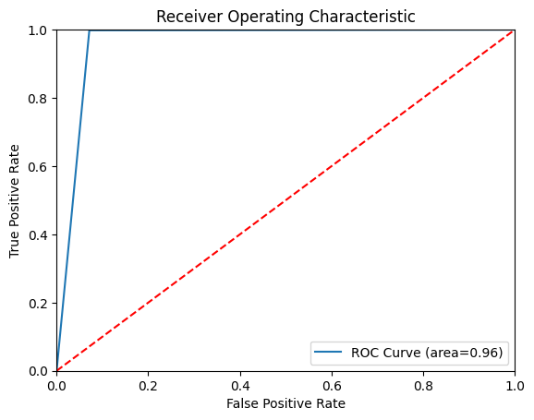
ROC Curve of Method 1

Slide 18
Method 2
Method 2 approach is to removing features.
Dropping 'Month','OperatingSystems','Browser','Region','TrafficType’.
Because these features are having biased data & weakly correlated with target variable .
Converting the object & Boolean features to integers features.
Creating independent & dependent variable split.
Balancing the data.
Feature Scaling
Model building
Model Evaluating.
AUC ROC plot

Slide 19
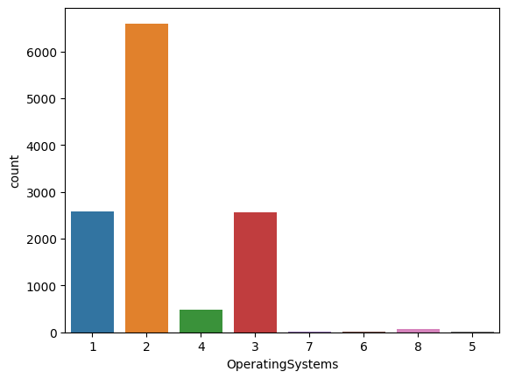
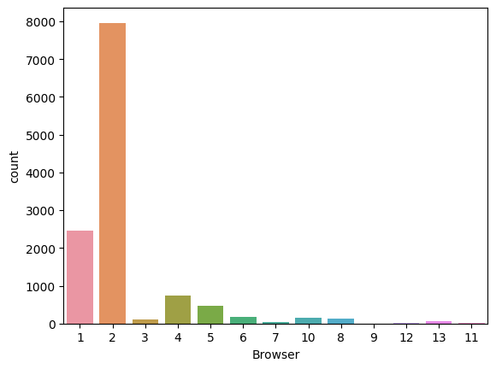
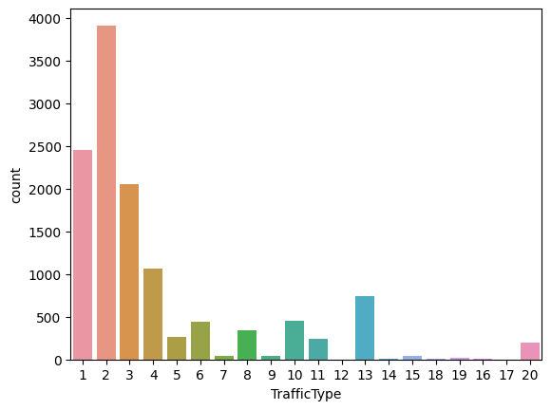
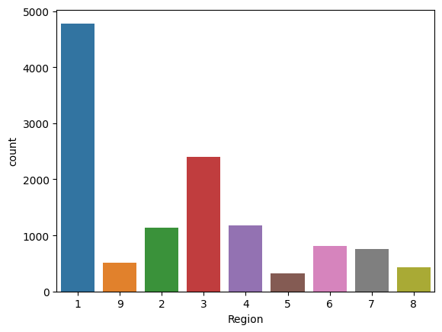

Slide 20
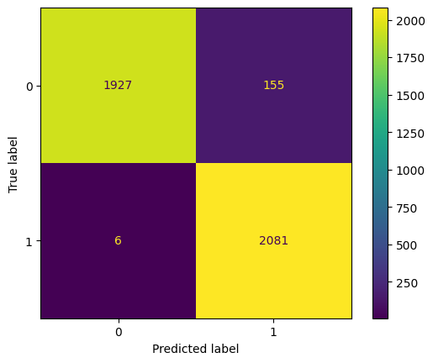

Random Forest Gini & Entropy accuracy are almost identical

Slide 21
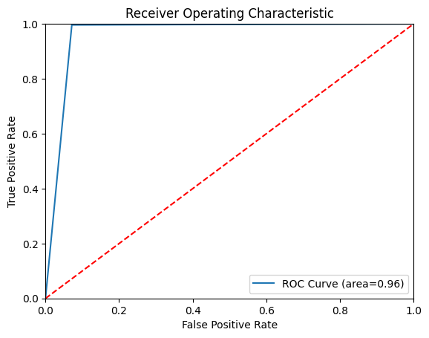
ROC Curve of Method 2

Slide 22
Conclusion
Method 2 is much suitable for the prediction of revenue or non revenue generator visitor on site for the online shopper intention project.
Random Forest Gini is predicting less false positive than Random Forest Entropy, and our data is mostly contains 0 values Therefore in action the Random Forest Gini will perform effectively.
Also because of removing unnecessary features model deployment, database size & speed of the software/app becomes more efficient.

